Slide 1
What is “AI”?
More specifically, how do Large Language Models work?

Slide 2
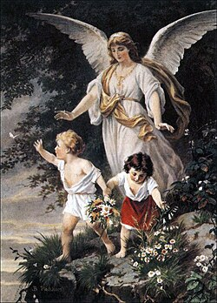
Disclaimer
I am not an expert in AI or LLM
I have built my own “LLM” but it’s a toy
  It’s called Bert_3010 and it’s not allowed to leave my basement
It is in my interest to convince you that AI is just statistics
  Keeps me in a job
  Inflates my ego
I do believe that what I’m saying is true
  But I am not impartial

Slide 3
What’s the difference?
When talking to a CEO, it’s Artificial Intelligence.
When talking to a head of department, it’s Machine Learning.
When talking to a line manager, it’s Data Science.
When talking to a colleague, it’s Statistics.

Slide 4
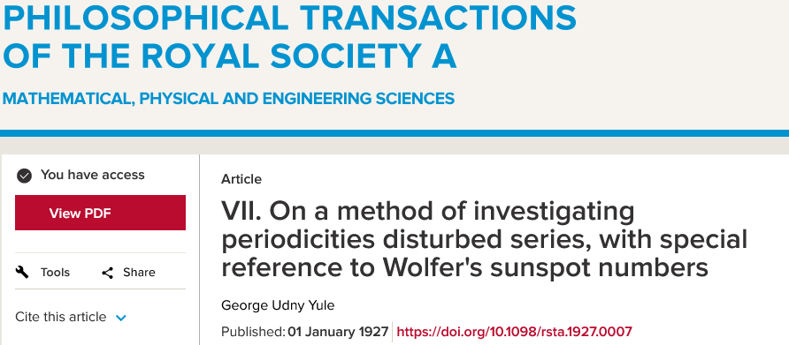
“Statistics is great and all, but it can’t do things like analyse time series”
Professor of Machine Learning Engineering
(from a very prestigious university)

Slide 5
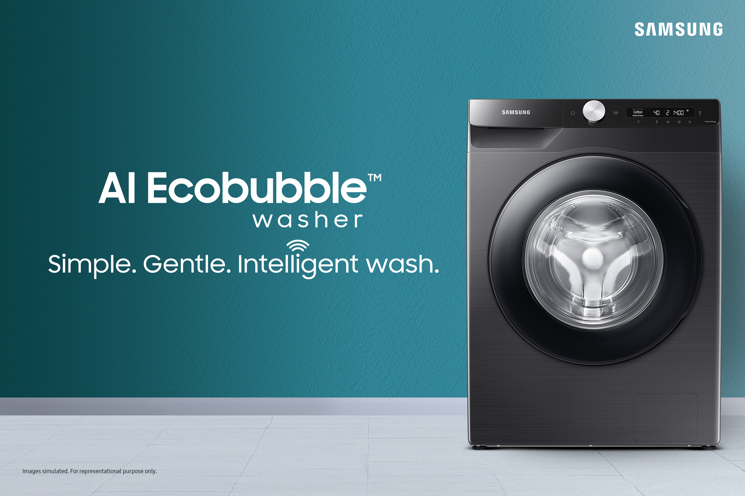
Artificial Intelligence
AI is largely a marketing term
  Incredibly loose definition
  Very often a GLM
  But can mean a large language model
  At times, it’s just clever conditional code
AI, or “genAI”, mostly taken to mean Large Language Models (LLMs)
  ChatGPT, Claude, Co-Pilot, etc.
  AI that produces text
Image generators (Diffusion models) similar but distinct
  Midjourney etc.
  AI that produces images (and videos)
Vagueness breeds misunderstanding
> name <- “Deon”
> if(!is.null(name)) {
+ print(paste(“Hello”, name))
+ } else {
+ print(“Hello”)
+ }
[1] “Hello Deon”

Slide 6
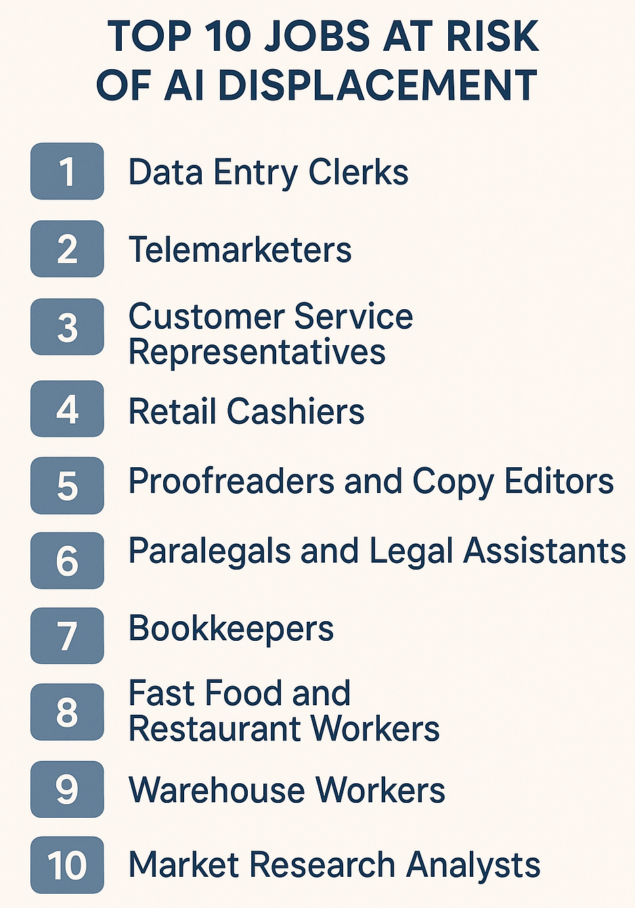
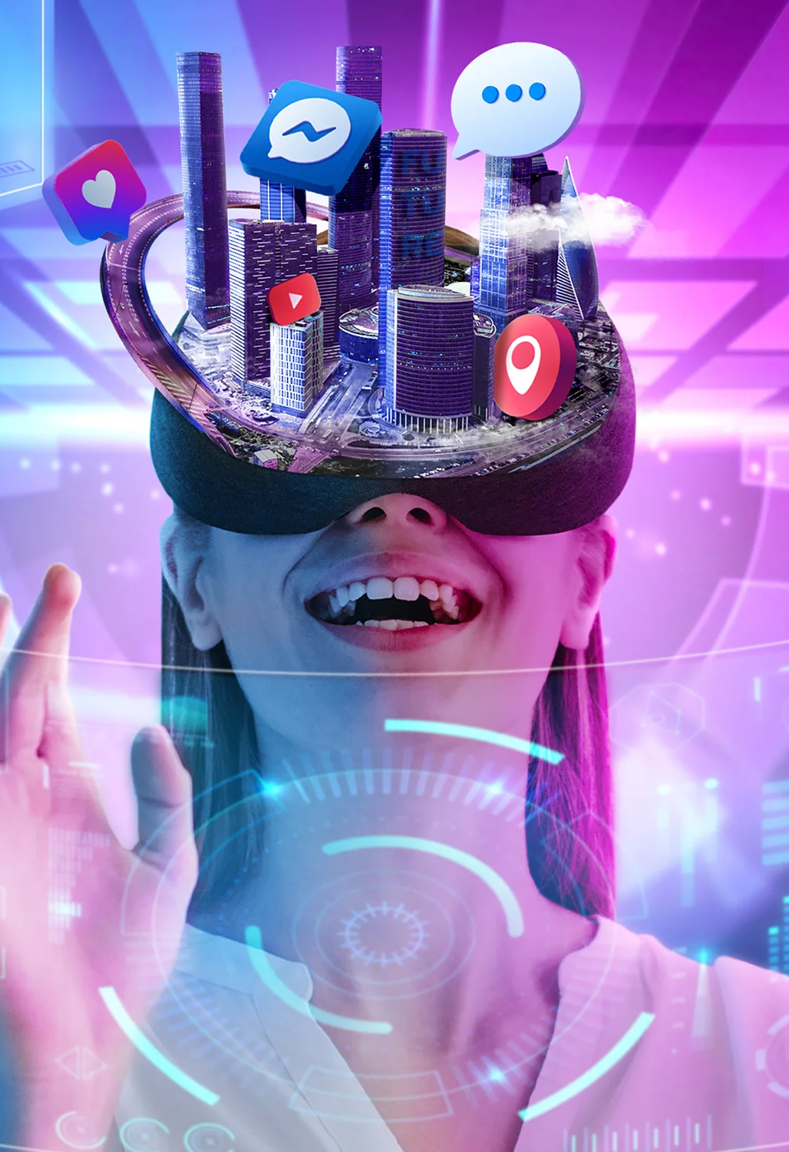
“AI” is a marketing term
Important distinction to be made between:
  “Artificial Intelligence” as used in marketing
  The actual models
A lot of misunderstanding comes from understanding “AI” as described in marketing
Marketing sometimes done by the companies
  But mostly by people just talking about AI
  If you say “AI is inevitable” you’re doing the marketing for Google
Why correct misunderstandings if it benefits you?

Slide 7
Vagueness breeds misunderstanding

Slide 8
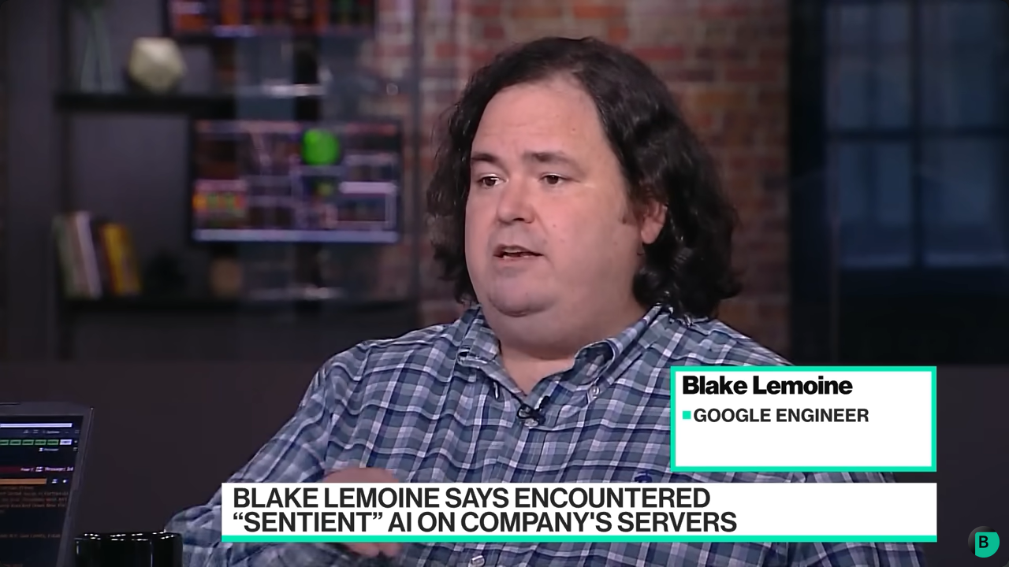
“AI is sentient”

Slide 9
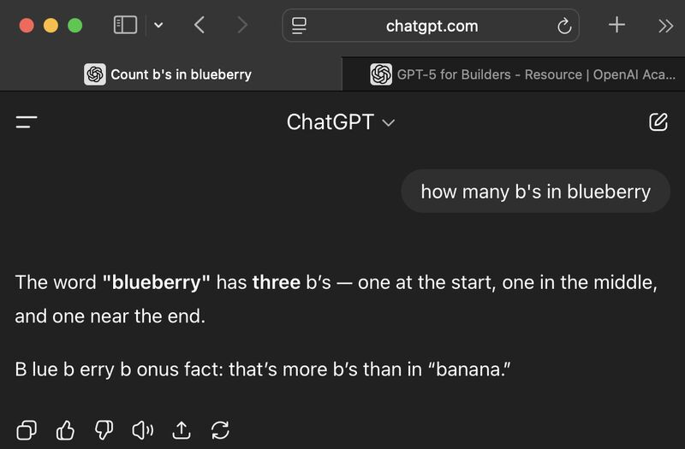
“LoL It’S So dUMB! It CAN’t do MAthS”

Slide 10

“AI is smarter than humans”

Slide 11
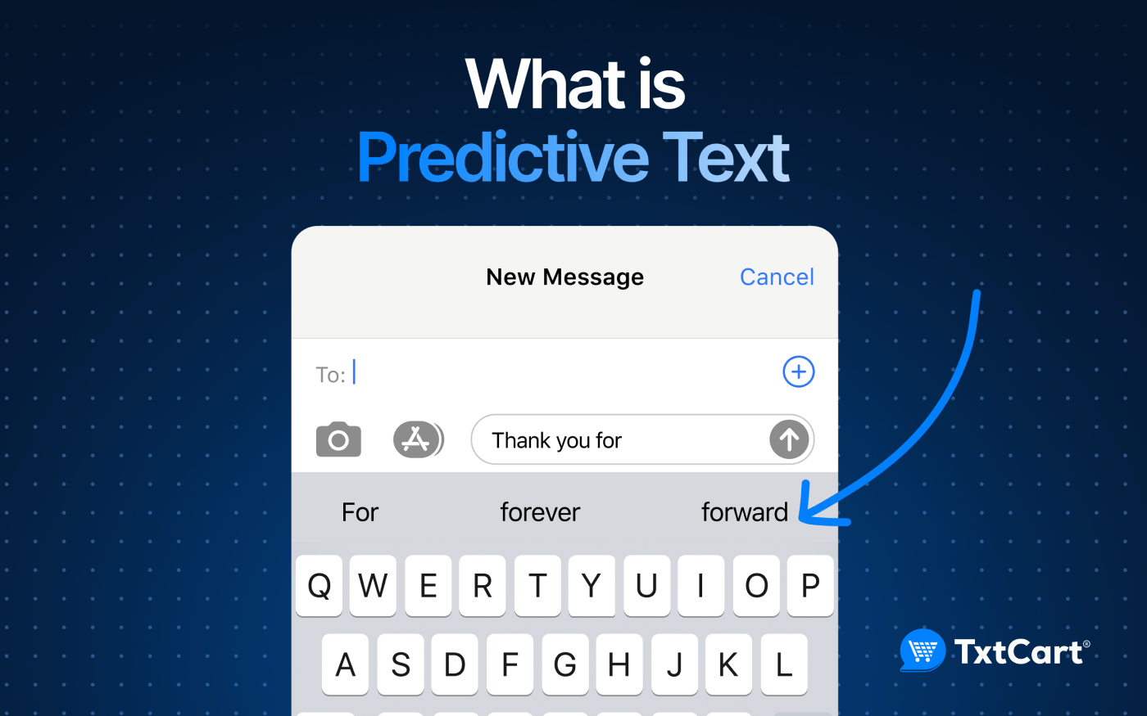
“AI is just a parrot”

Slide 12

“It’s gonna take your jobs”

Slide 13

“AI is objective and unbiassed”

Slide 14

Sloppy terminology
Terminology used in machine learning partly to blame
Anthropomorphise models
  Machine “learning”
  Model “training”
  “Neural network”
  “Attention”
  “Thinking”
  “Agent”
All imply a level of consciousness
All have much more boring terms that could be used
  “Fit” rather than “train”

Slide 15

So what is a large language model?
What follows is a crude summary explanation intended to give an intuitive understanding.
I’ll describe LLMs as having three “stages”
Tokenisation (akin to data processing)
Embedding (akin to multivariate analysis)
Transformer (akin to stacked GLMs)
Technically, this is then passed to a chatbot which you interact with.

Slide 16

Tokenisation
Relatively simple process
Takes text, separates it into words and splits them up into tokens
For example:
The seagull was seen stealing chips on Union Street as people cowered in fear
Becomes:
“The”, “ se”, “ag”, “ull”, “ was”, “ seen”,
“ stealing”, “ chips”, “ on”, “ Union”, “ Street”,
“ as”, “ people”, “ c”, “ower”, “ed”, “ in”, “ fear”

Slide 17
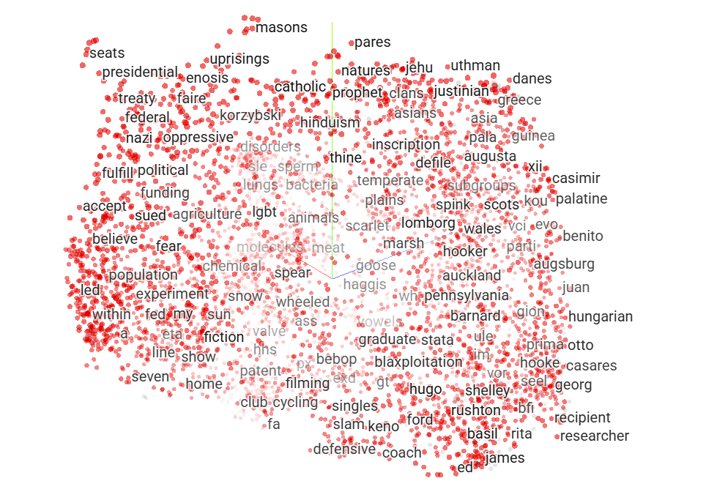
Embedding
Which are more similar?
  “King” and “Queen”
  “King” and “Chair”
Embedding converts tokens into a series of numbers that represents this “similarity” across all other tokens
Embedding values change depending on context
  What if we added “Throne”?
If we see the token “King”, what other tokens are we most likely to see?
Embedding is where the model captures context
Queen
King
Throne
Chair

Slide 18
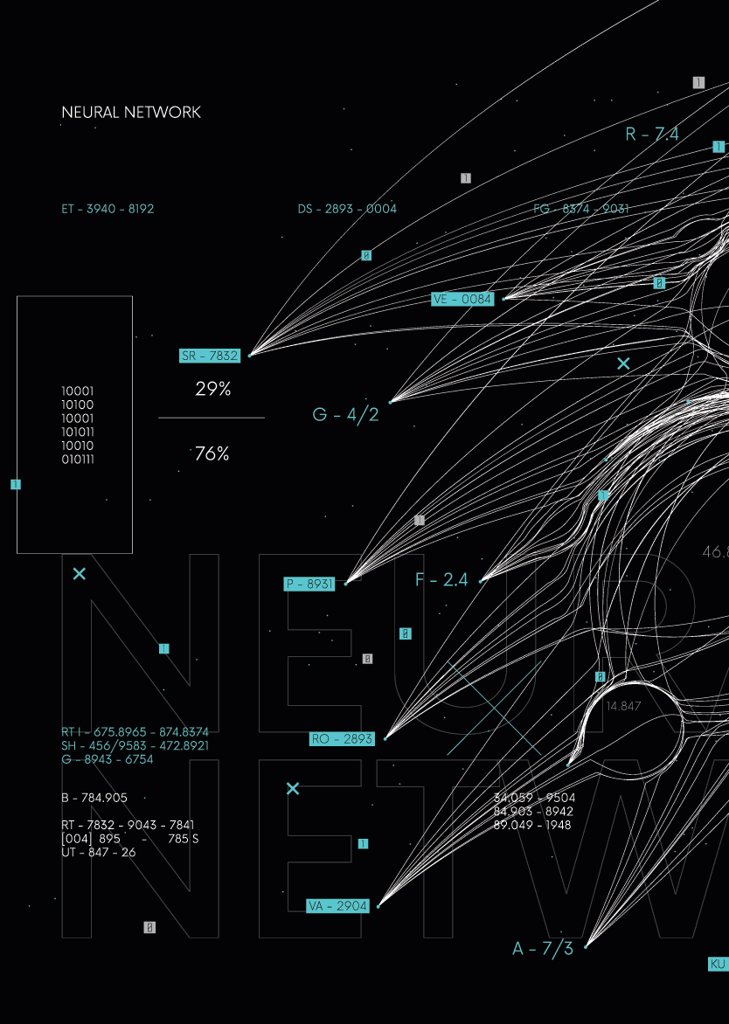
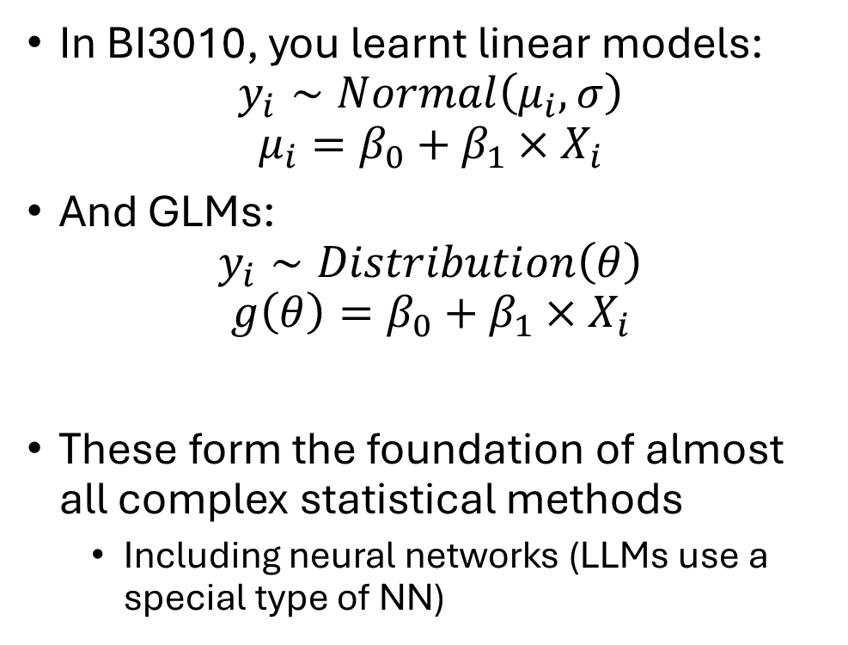
Neural networks
In BI3010, you learnt linear models:
$$y_{i}∼Normal\left(μ_{i},σ\right)$$
$$μ_{i}=β_{0}+β_{1}×X_{i}$$
And GLMs:
$$y_{i}∼Distribution\left(θ\right)$$
$$g\left(θ\right)=β_{0}+β_{1}×X_{i}$$
These form the foundation of almost all complex statistical methods
  Including neural networks (LLMs use a special type of NN)

Slide 19

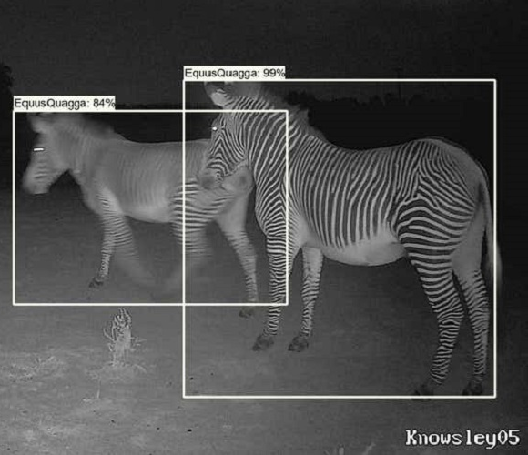
Neural networks
Common method used in:
  Image recognition
  Social media “algorithms”
  Translation software
“Engine” in both LLMs and Diffusion models
Highly flexible approach
  Good for non-linear relationships
Only useful for predicting
  Useless for understanding

Slide 20

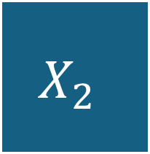
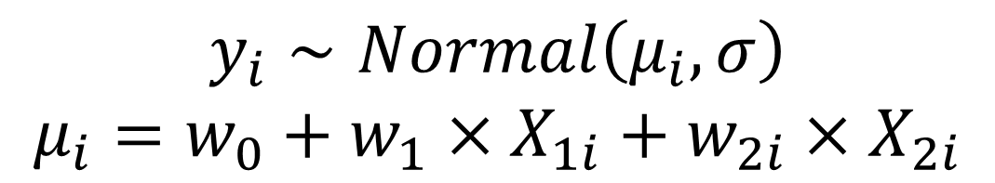




Linear model as a neural network
NN often doesn’t use a distribution (a.k.a. likelihood) as the metric to minimise
$$X_{1}$$
$$w_{1}$$
$$Y$$
$$X_{2}$$
Linear
$$w_{2}$$
$$y_{i}∼Normal\left(μ_{i},σ\right)$$
$$μ_{i}=w_{0}+w_{1}×X_{1i}+w_{2i}×X_{2i}$$
In LLM $X_{1}$, $X_{2}$ and $Y$ are embedding values

Slide 21
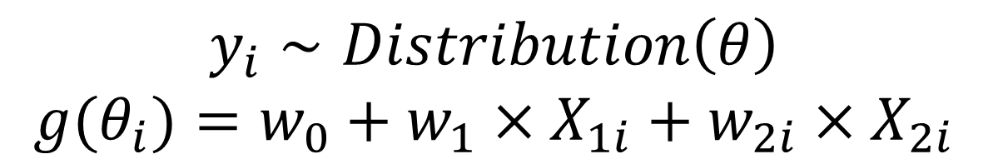


GLMs as a neural network
Link functions are called “Activation Functions” in machine learning
$$X_{1}$$
$$w_{1}$$
$$Y$$
Link function
$$X_{2}$$
Linear
$$w_{2}$$
$$y_{i}∼Distribution\left(θ\right)$$
$$g(θ_{i})=w_{0}+w_{1}×X_{1i}+w_{2i}×X_{2i}$$
$$y_{i}∼Normal\left(μ_{i},σ\right)$$
$$μ_{i}=w_{0}+w_{1}×X_{1i}+w_{2i}×X_{2i}$$

Slide 22
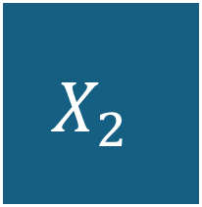






Neural networks tend to have multiple layers
$$X_{1}$$
$$w_{1}$$
$$Y$$
$$w_{4}$$
$$w_{2}$$
Link function
Link function
Link function
$$X_{2}$$
$$g\left(θ_{i}\right)=w_{0}+w_{1}×X_{1i}+w_{2i}×X_{2i}$$
$$g\left(ζ_{i}\right)=w_{3}+w_{4}×θ_{i}$$

Slide 23
And multiple neurons
$$X_{1}$$
Link function
$$Y$$
Link function
Link function
$$X_{2}$$
Link function
Link function

Slide 24
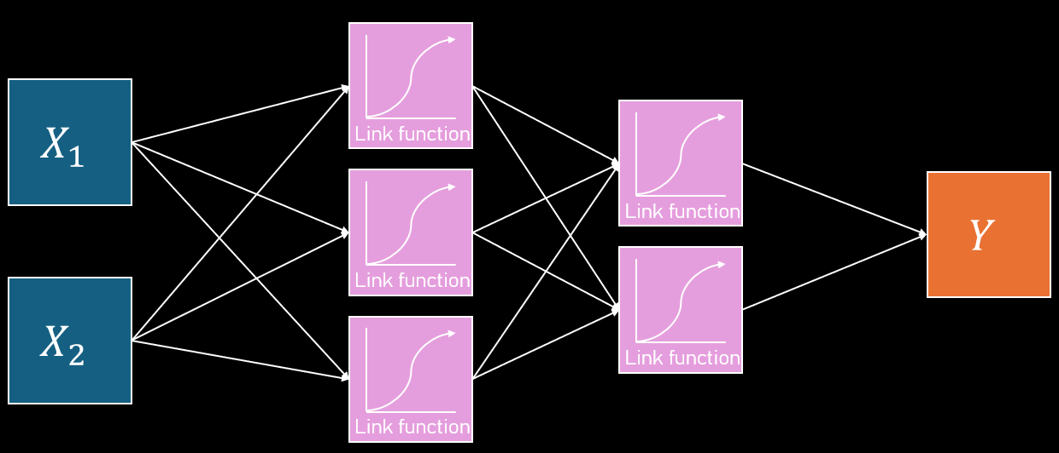
NN can be fit in R
Surprisingly easy to fit neural networks in R
model <- keras_model_sequential() |>
layer_dense(3, “sigmoid”, input_shape = 2) |>
layer_dense(2, “sigmoid”) |>
layer_dense(1) |>
compile(loss = “mse”, optimizer = “adam”)
mse is mean squared error.
This neural network is a series of stacked linear models.

Slide 25
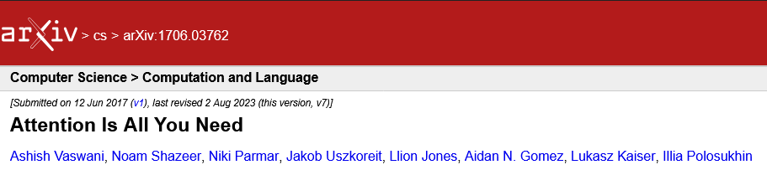
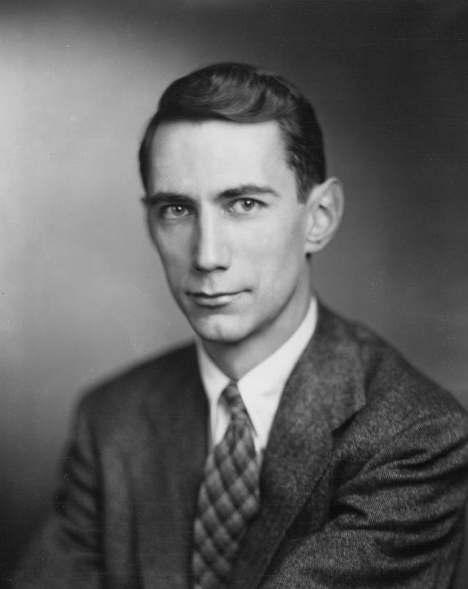
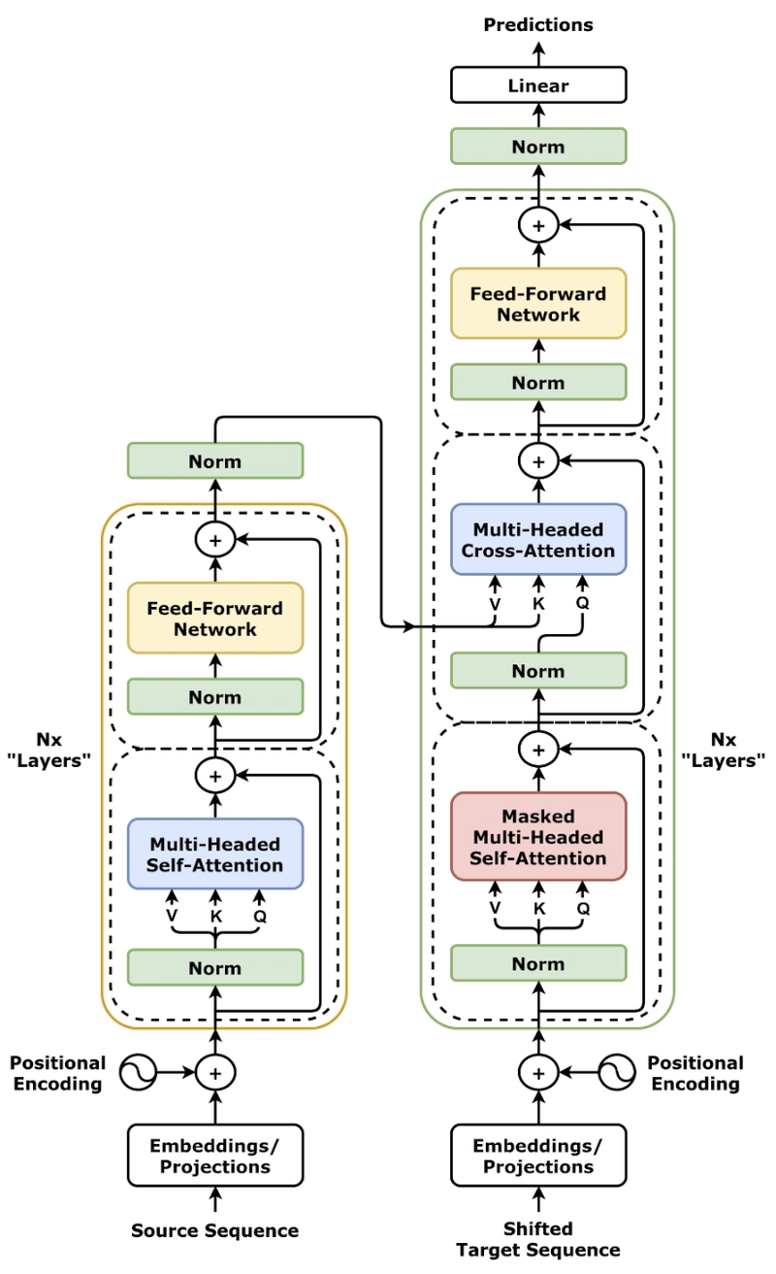
Transformers
Language models have been around since the 1940’s
  E.g. n-gram models developed by Claude Shannon
  Also include extensions/derivations like Structural Topic Models
    Grace Sommerville is using STMs for their Honour’s project
Neural networks were a big advancement but:
  Slow and inefficient, and bad at retaining information
Transformers are a type of a neural network model
  Crucially, use “attention” to let each token relate to all others in a sequence
  Much faster than previous versions of NN
  Allow context-sensitive meanings, such as distinguishing “river bank” from “money bank”

Slide 26






Here’s how transformers kind of work
$$y$$
lynx released today edinburgh locals fed whiskers cat food offer buckfast…
$$Tok_{−11}$$
$$Tok_{−3}$$
$$Tok_{−2}$$
$$Tok_{−1}$$
What comes next?
$$y=β_{0}+β_{1}×Tok_{−1}+ …+β_{N}×Tok_{−J}$$
This is a type of linear model called an “autoregressive model”
  GPT3 did this for up to previous 4096 tokens (not just 11 like in above example)
Transformers are smarter because they also consider how $Tok_{j}$ is related to all other tokens
  Not just the token we are trying to predict
$y$ is returned as a probability distribution for the next token
  GPT5 predicts $y=instead$
GPT stands for “Generative Pre-trained Transformer”
  Basically, “a transformer neural network that has already been fitted which can generate text.”

Slide 27
Context window
Introduction
“GPT3 did this for up to previous 4096 tokens”
The length of tokens considered is called the context window
If a document has 4096+1 tokens, then the start and end of the context window do not get considered together
Can lead to disconnected text that goes on tangents
Keep in mind that rare words tend to be broken up into smaller tokens
  So in a thesis, even if the word limit is 5000 words, this will often end up with far more than 5000 tokens
  LLMs may not be able to link your introduction with your conclusion
Context
window
Discussion

Slide 28
NN use the same tricks you know
A NN is just a model with a collection of parameters that have to be estimated
Uses data to estimate parameter values
Will often use residual error to estimate parameters
Uses optimisers to do the estimation
  Generally, one called Gradient Descent (often Adam or variants specifically)
The “learning” in Machine Learning and “intelligence” in AI is what you’ve been doing this entire course
  It’s just estimating parameters from data

Slide 29
And lots of tricks you don’t know
Multi-head attention
  Allows the model look at tokens in multiple different ways at once
Feed forward networks
  Allows each parameter to be re-estimated before passing on to next stage of model
Parameter scale
  Current versions use billions of parameters (hence computational requirements)
Multiple data sources
  Early models used text just from data, but new models now use data collected from users and from experts
  And combine these within the model

Slide 30



Large Language Models
Convert words to tokens
Estimate embedding value to capture “similarity”
Use embeddings as explanatory and response variables
$$X_{1}$$
“The”, “ se”, “ag”, “ull”, “ was”, “ seen”,
$$Y$$
$$X_{2}$$

Slide 31
When good AIs turn bad

Slide 32



Output are predictions
$$X_{1}$$
“The”, “ se”, “ag”, “ull”, “ was”, “ seen”,
$$Y$$
$$X_{2}$$
You created “prompts” during BI3010
fake <- data.frame(x = 0:10)
predict(model, newdata = fake)
What you see as output from a LLM is the equivalent to the output from predict()
Predictions are relatively energy efficient. Fitting models are massively more energy expensive.

Slide 33

Why do LLMs hallucinate?
$$X_{1}$$
“The”, “ se”, “ag”, “ull”, “ was”, “ seen”,
$$Y$$
$$X_{2}$$
There’s no intelligence in AI
LLMs predict $y$
There is no way for it to know if $y$ is sensible or not. It only knows that the sequence of tokens it has predicted is the most likely one
Without additional scaffolding, LLMs will always hallucinate
  Hallucinations are not the model “being creative”
If prediction is consequential, always double check

Slide 34

Why are LLMs bad at maths?
$$X_{1}$$
“The”, “ se”, “ag”, “ull”, “ was”, “ seen”,
$$Y$$
$$X_{2}$$
These are language models
  Expecting it to do maths is a failure of the user and the result of marketing
Some chatbots will now recognise maths questions, do the calculations in python and return the output
  A crude but workable solution that obscures the limitation
  ChatGPT does not do this by default unless the problem is complex or you request it
LLMs increasingly used as coordinator of other apps
  python
  Microsoft Bing
  Calculators for simple calculations
  Diffusion models for image generation

Slide 35
LLMs for coding
$$X_{1}$$
“The”, “ se”, “ag”, “ull”, “ was”, “ seen”,
$$Y$$
$$X_{2}$$
LLMs are great at predicting repetitive, consistent and logical language
  I.e. programming languages
LLMs great for mundane and fiddly coding tasks
Used to be unreliable for more complex code but increasingly better
  Not 100% though – lots of back and forth
Fundamentally, you need to know how the code should work
  Theory and ideas now far more important than implementation

Slide 36
“Prompt engineering”
$$X_{1}$$
“The”, “ se”, “ag”, “ull”, “ was”, “ seen”,
$$Y$$
$$X_{2}$$
The less information rich your prompt, the less quality data the model has to predict from
  Predictions become increasingly “average” and extremely generic
Richer context in your prompt usually helps, but it also depends on whether your prompt matches patterns the model has seen
  Aim to guide the model towards the patterns it has likely seen before
So give it lots of context
  “Write an essay about red deer overabundance” will produce an essay
  But it will be extremely and painfully generic
Can’t interpret what you’ve asked – just predicts

Slide 37
Hidden assumptions
$$X_{1}$$
“The”, “ se”, “ag”, “ull”, “ was”, “ seen”,
$$Y$$
$$X_{2}$$
Early versions of LLMs performed poorly mostly (or at least in part) because their data was low quality
  Companies just scraped text from the web
  Assumption of validity and assumption of representativeness
Some of the “big” advancements have really been about improving the underlying data quality, not the modelling
  E.g. “Which option do you prefer?” or employing PhDs to write questions and answers for topics

Slide 38
Caution of hype
$$X_{1}$$
“The”, “ se”, “ag”, “ull”, “ was”, “ seen”,
$$Y$$
$$X_{2}$$
AI companies now talk about AGI
  Artificial General Intelligence
Given the fundamental structure, I don’t see how this is justified
  But the companies no longer share code, so who knows?
  Some interest in “Type 1” versus “Type 2” thinking but these are refinements not revolutions
Strikes me as the equivalent of string theory in physics
  “We’re so close to cracking it, just give us 10 more years”

Slide 39
With even a basic understanding…

Slide 40



“AI is sentient”
$$X_{1}$$
“The”, “ se”, “ag”, “ull”, “ was”, “ seen”,
$$Y$$
$$X_{2}$$

Slide 41
“LoL It’S So dUMB! It CAN’t do MAthS”
$$X_{1}$$
“The”, “ se”, “ag”, “ull”, “ was”, “ seen”,
$$Y$$
$$X_{2}$$

Slide 42
“AI is smarter than humans”
$$X_{1}$$
“The”, “ se”, “ag”, “ull”, “ was”, “ seen”,
$$Y$$
$$X_{2}$$

Slide 43
“AI is just a parrot”
$$X_{1}$$
“The”, “ se”, “ag”, “ull”, “ was”, “ seen”,
$$Y$$
$$X_{2}$$

Slide 44

“AI is objective and unbiassed”
$$X_{1}$$
“The”, “ se”, “ag”, “ull”, “ was”, “ seen”,
$$Y$$
$$X_{2}$$

Slide 45
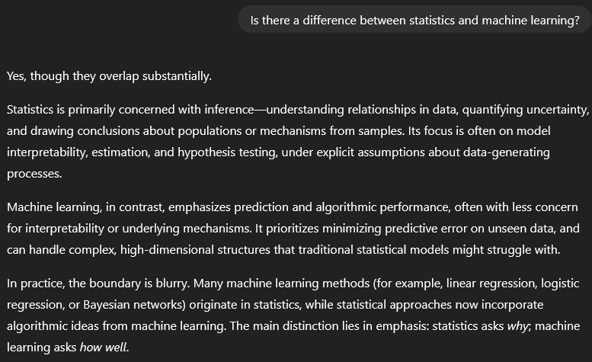
“AI is objective and unbiassed”
“Statistics is great and all, but it can’t do things like analyse time series”
Professor of Machine Learning Engineering
(from a very prestigious university)

Slide 46
What to remember about LLMs
LLMs are statistical models of language, not intelligent beings
They predict the most likely next token, not “truth”
Their strength lies in scale and pattern recognition, not reasoning
Great for: drafting, summarising, routine writing and coding
Weak for: complex reasoning, novel ideas, statistics, facts
Responsible use: treat outputs the same as you would for any of your own models
LLMs are impressive tools. But they are neither magic nor sentient minds and are not a substitute for expertise.
They remove implementation barriers. They do not remove the need for knowledge.

